Slide 1


EcoBin
Advancing Canadian waste sustainability
Team 6ix

Slide 2
Who are we?
01
Danial Sheikh
Business Analyst
02
Risi Zani
UI/UX
03
Grace Liu
Developer
04
Hasaan Soomro
Data Scientist

Slide 3
NO.1 Presentation
Waste Sustainability is a prominent issue
Improper Recycling
Contamination
Economic Impact
Canadians not well educated in recycling
Garbage contamination rates are high
Export revenues of waste lowered

Slide 4

Persona Analysis
Uncovering the dirty details on Canadian recycling habits
25%
In the cities with the dirtiest recycling, Toronto and Edmonton, contamination rates can be upwards of 25%.
Waste Mismatch
Canadians are throwing too much garbage into recycling bins
Contaminations
Even a few spoons of peanut butter left in a jar can contaminate a tonne of paper and make it unusable
Alternate Solutions
Clara Adams
Many cities are struggling to clean up their recycling and lower their contamination rates, but the potential solutions also have high costs and trade-offs

Slide 5
How can we educate Canadians on the benefits of recycling properly and reduce the economic impact of contaminated recyclables?

Slide 6
Economic Impact
Increase in Global Standards
China has dropped their waste impurity rate to 0.5%
Difficult Decisions
The sharp drop in profits has put municipalities at a crossroads: raise taxes or cut programs.
Cost to Toronto
Toronto alone has lost between $8-million and $9-million last year in revenue.
Cutting Programs
Kawartha Lakes, Ont. has backed away from educating youth on recycling in lieu of tax raises.
Eliminating Recycling Entirely
Some U.S. communities have cancelled their recycling programs.

Slide 7
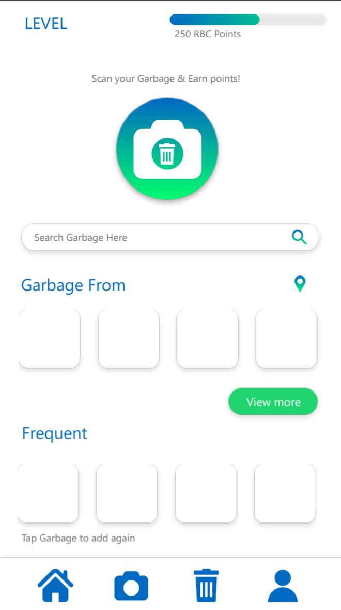
Introducing
EcoBin
Minimalistic, Vibrant, Fast & Sustainable App that promotes & makes sorting recycling simple by using your camera to sort it for you

Slide 8
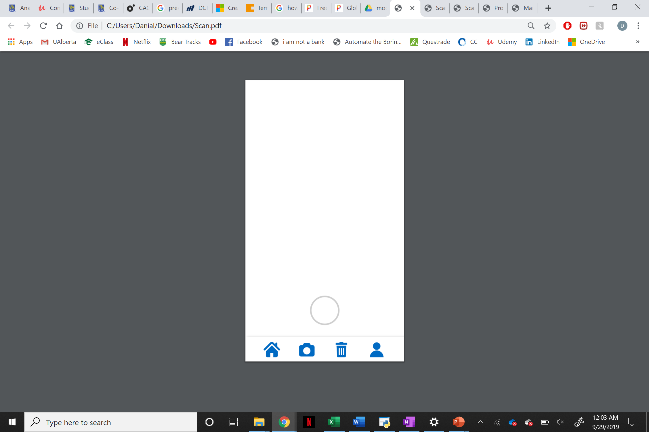
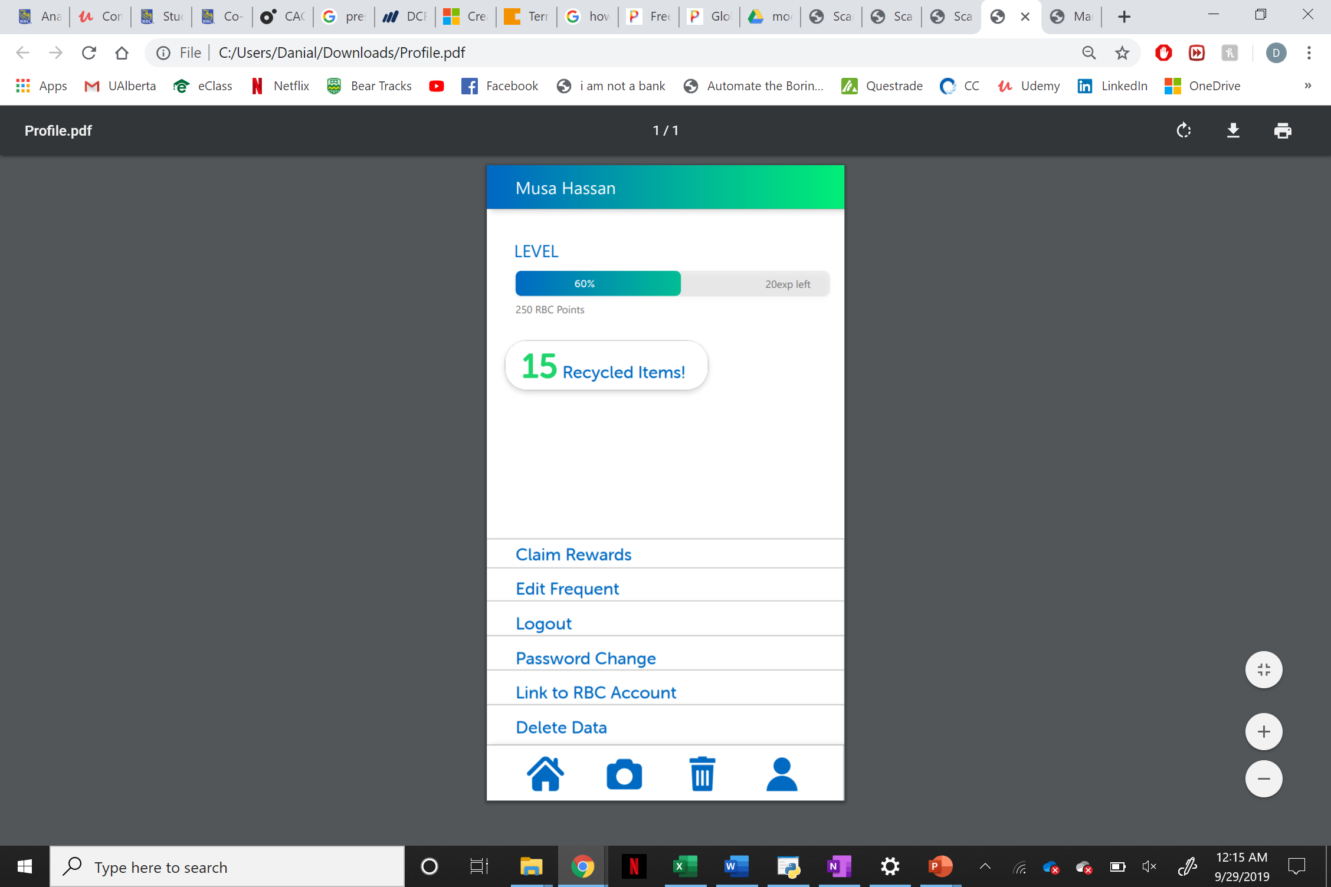
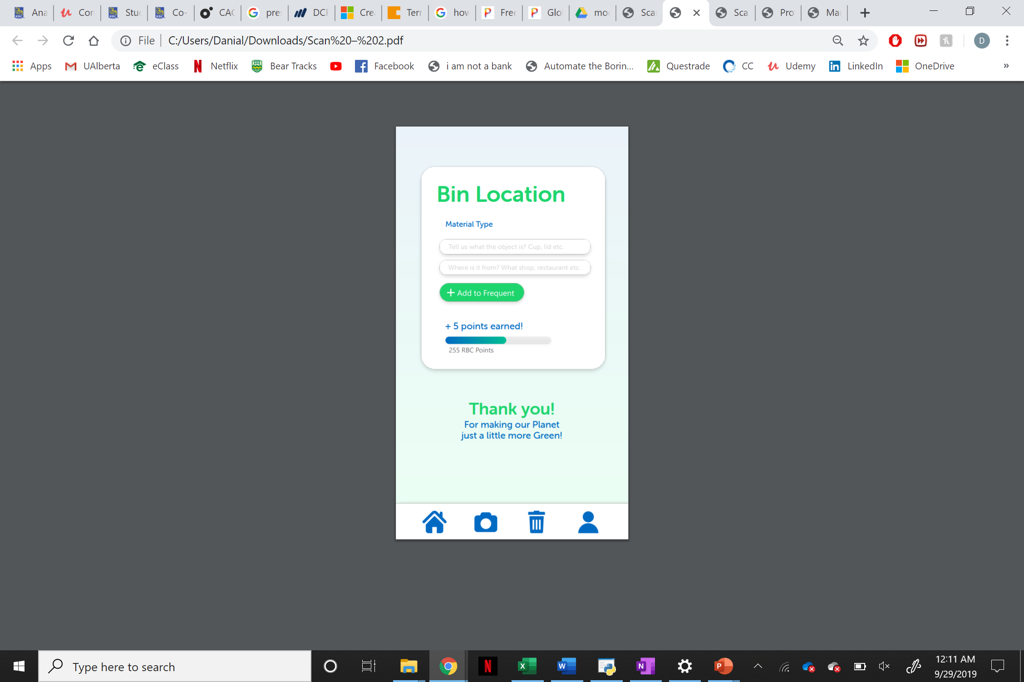
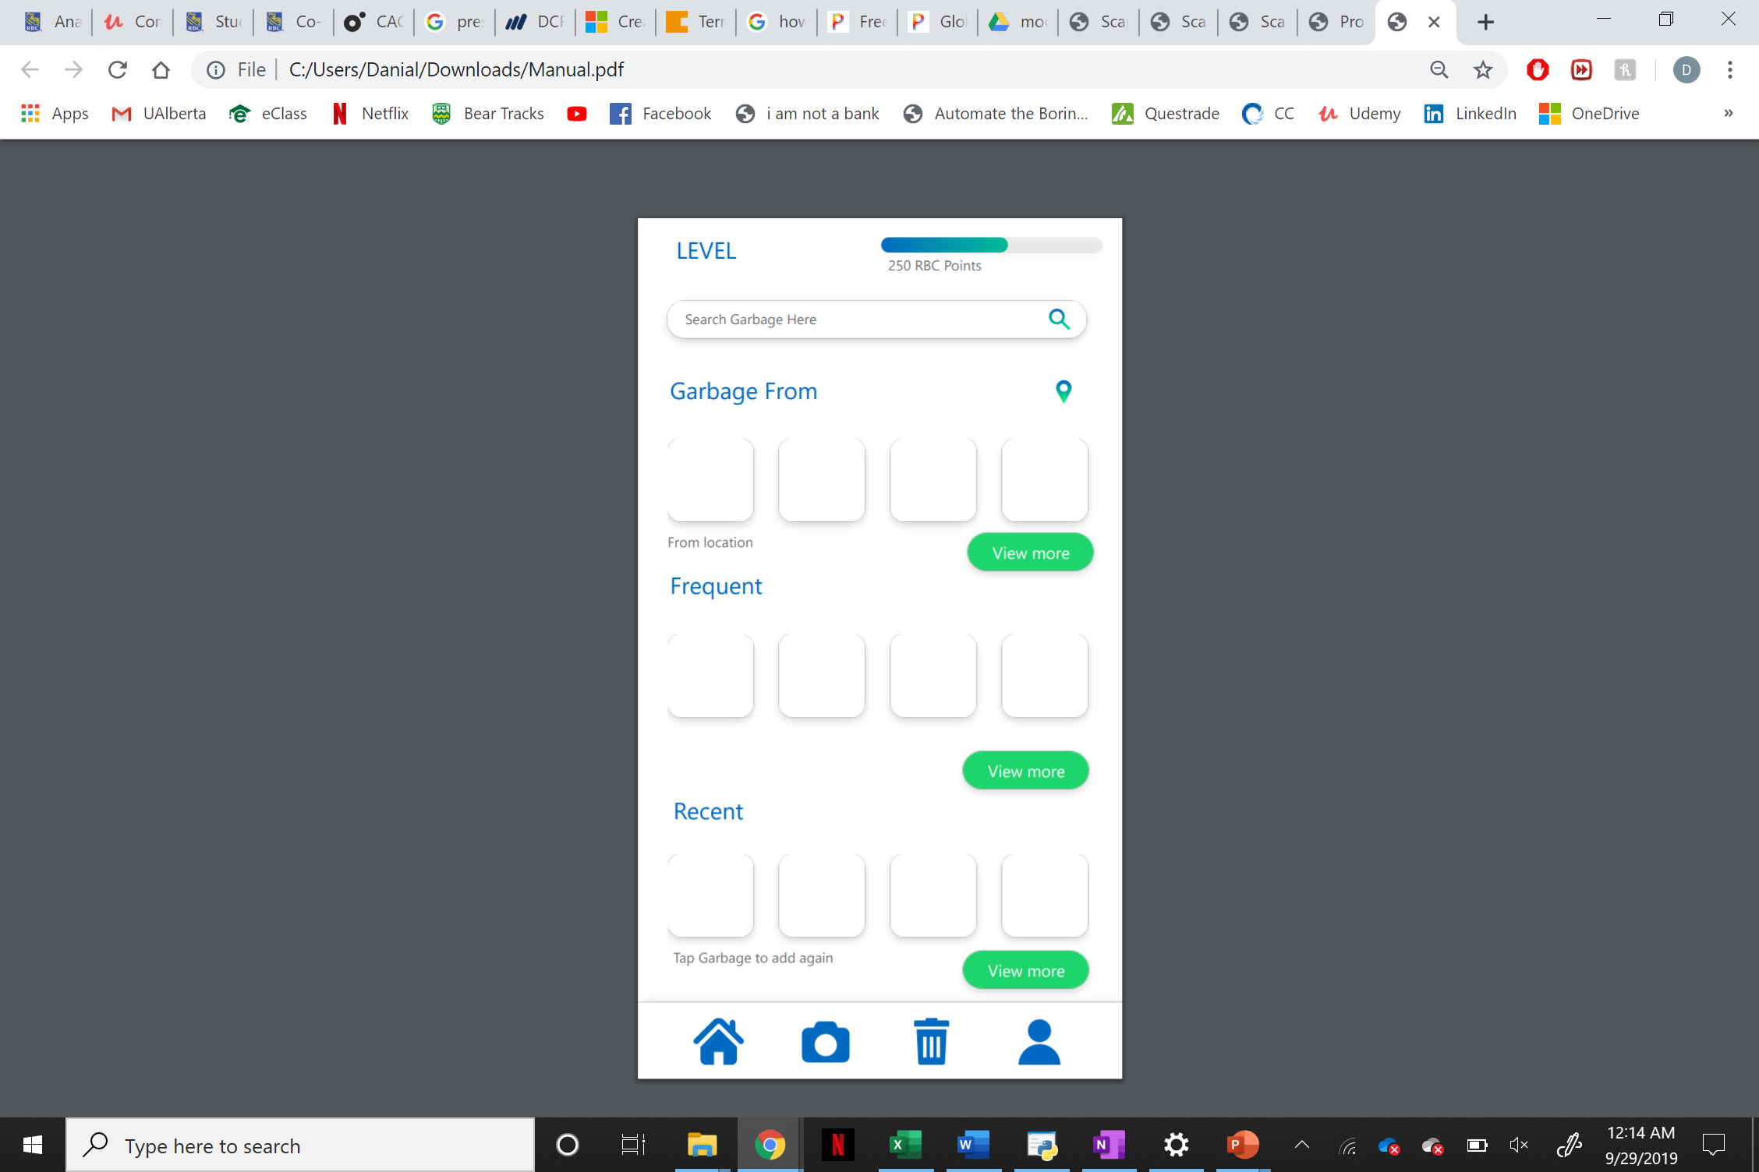
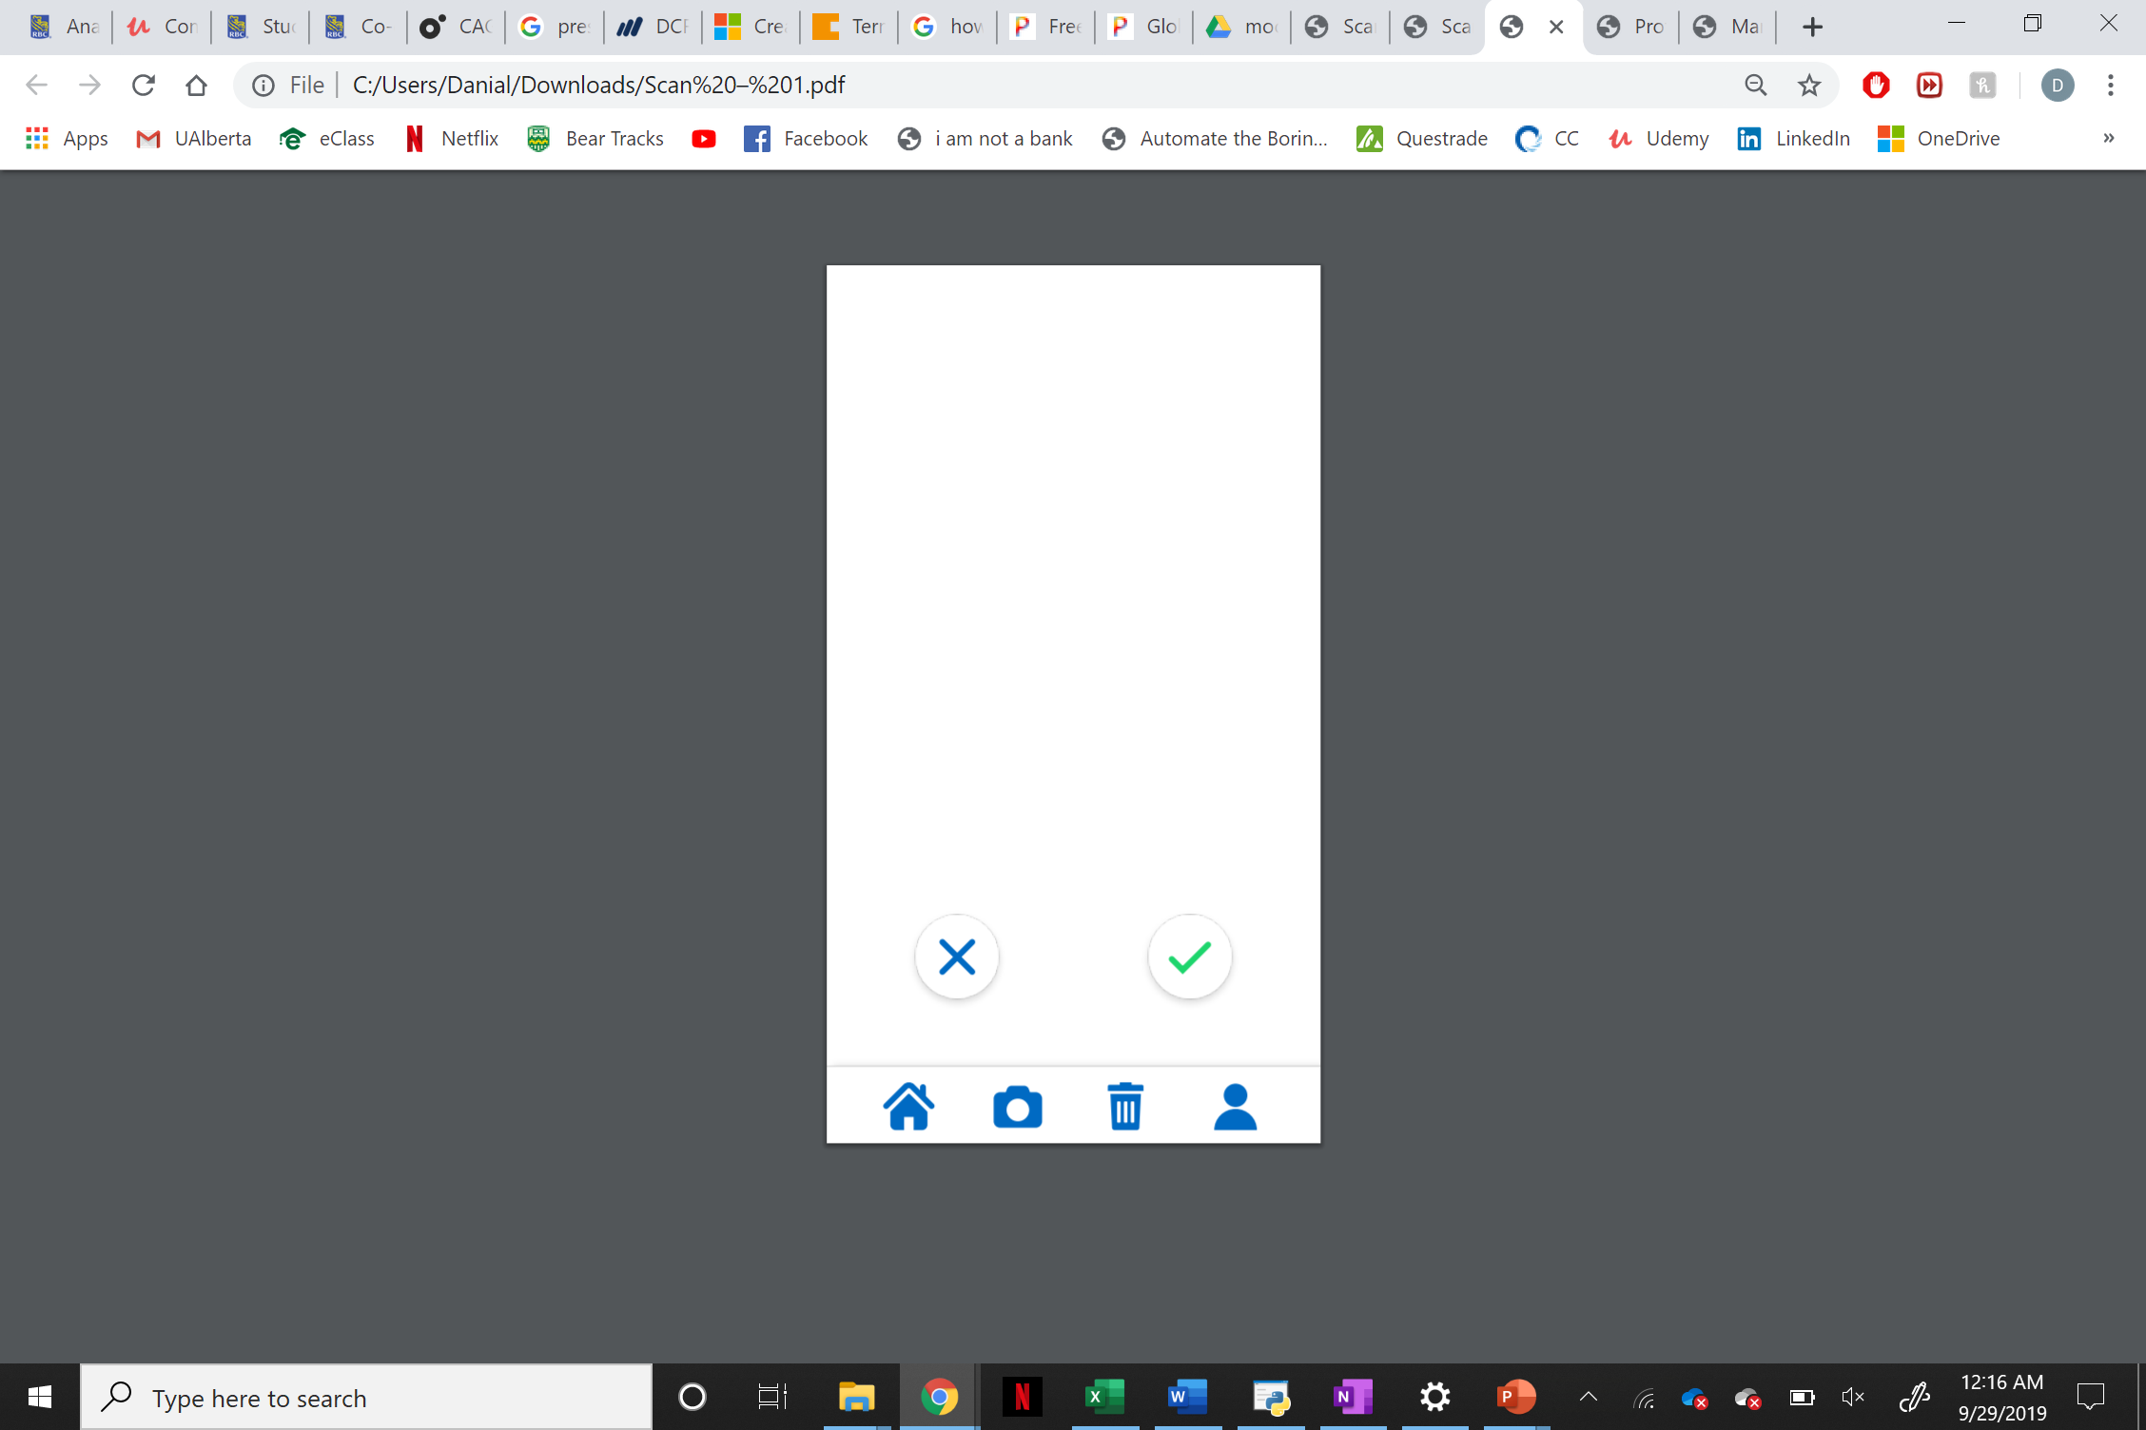
Introducing
EcoBin
Minimalistic & Vibrant
Minimalistic, vibrant, catering to a wide range of users. Made to be used daily
User friendly, Quick & Simple
Fast & Simple experience using hierarchy of importance, affordances, and a simple UI. Shortening the amount of time on the go
Data Collection
Data collected from the application may be sold back to local businesses to further educate on recycling

Slide 9
Introducing
EcoBin
Trash Geolocation
Takes in consideration of the location of the user, and locates the produced trash from shops, the food industry
Join and maintain active users
RBC Rewards points are used to attract and retain new users. Using gamification, earning at each level depending on the number of uses of the app
RBC forefront of sustainability
Improves RBC’s brand recognition and brings it to the forefront of sustainable development.

Slide 10
Front-End
Main Page
Components
Scan Garbage
Browse Garbage Categories
Browse Frequent Scans
Navigate Application

Slide 11
Financial Viability
Discount Cash Flow
Determining Financial Impact for wasted plastics
2020 ($7.8B)
2021
2022
2023
2024
2025
2026
2027
2028
2029
2030 ($11.1B)
CAGR
3.59%
Discount Rate
10%
Adoption Rate
0.5%
Adoption Rate
0.5%
Adoption Rate
1.0%
Adoption Rate
2.0%
Adoption Rate
3.0%
Adoption Rate
4.0%
Adoption Rate
4.0%
Adoption Rate
4.0%
Adoption Rate
5.0%
Adoption Rate
6.0%
Adoption Rate
6.5%

Slide 12
Financial Viability
Discount Cash Flow
Determining Financial Impact for wasted plastics
Present Value of Projected Savings after implementation
Present Value of Projected Costs
$133.9B
$6.4B

Slide 13
Economic Impact
With Current projections and expected adoption rates, we expect to lower plastic waste lost opportunity cost by 4.8% by 2030
60%
90%
4.8% Savings
Cash Flows
Present Value
80%
70%
Savings Cash Flows
Savings Present Value

Slide 14
Value to RBC
RBC Goals
Aligns with RBC’s sustainability development goals/values
Leadership
Leads RBC to the forefront of sustainable development
Consumer Base
Appeals to global community activism on important cause
Future Impact
Paves the way for more sustainable innovation through educating public
RBC Image
Improves brand recognition and image

Slide 15
THANK
YOU

Slide 16
Agenda

Slide 17
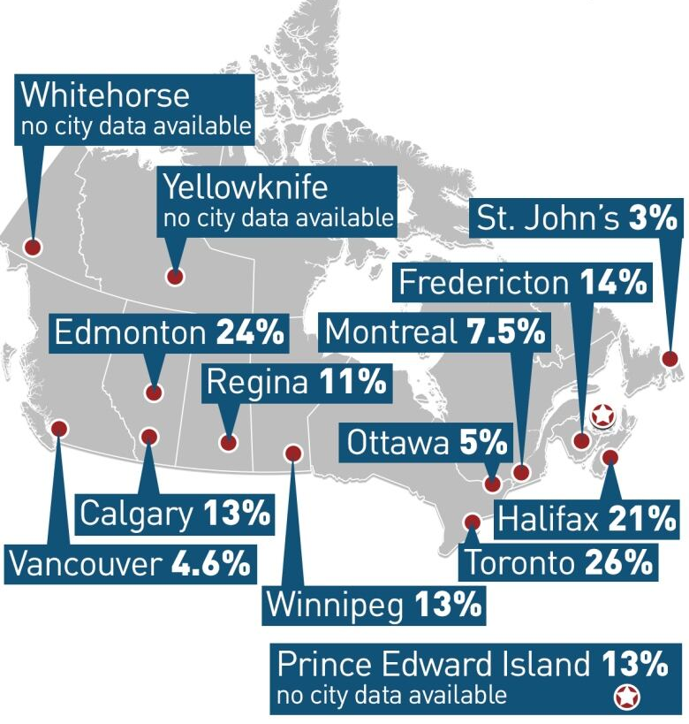
Contamination Rates of Residential Recycling
1%
=
$1MM
In recycling costs
(Toronto)

Slide 18
